Slide 1
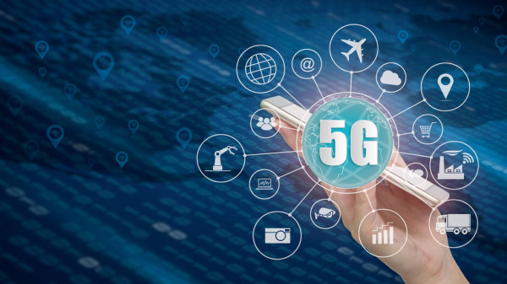
5G TECHNOLOGY
By: V Jaya Shravan

Slide 2
Table of content
Overview of 5G Technology
Evolution of 5G
Vision and Mission
Technologies used 5G
Features offered by 5G
Specification
5G general network architecture
Use cases
5G Devices
Status: Current status of 5G in India

Slide 3
5G Technology
What is 5G Technology…?
5G is a 5th generation mobile network. It will take much larger role than previous generations.
5G will elevate the mobile network to not only interconnect people, but also interconnect and control the machines, objects and devices.
It will deliver new levels of performance and efficiency that will empower new user experience and connect new industries.

Slide 4
5G Evolution
Before 5G there was other mobile networks which helps to world at their time.
Almost everything that we want……!!
5G
LTE - Ushered in the era of mobile broadband
4G
Brought mobile data (e.g CDAM2000)
3G
Digital voice (e.g CDMA)
2G
Analog voice
1G

Slide 5

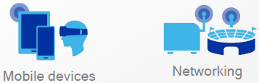

5G Vision
5G
Enhanced Mobile Broadband
Multi-Gbps data rates
Extreme capacity
Uniformity
Deep awareness
Massive Internet of Things
Low cost
Deep coverage
Ultra-low energy
High density
Mission Critical Services
Ultra-low latency
High availability
High reliability
Strong security

Slide 6
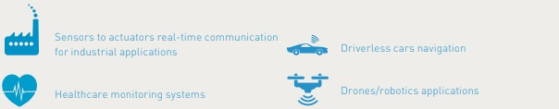
5G Features
The main features are high speed, low latency and low cost.
Beyond speed improvement, 5G is expected to unleash a massive IoT (Internet of Things) ecosystem where networks can serve communication needs for billions of connected devices, with the right trade-offs between speed, latency, and cost.
5G technology offers an extremely low latency rate, the delay between the sending and receiving of information.
Use cases associated with low latency are:
V2X, V2I, V2V, autonomous, connected cars
Immersive Virtual Reality Gaming
Remote surgical operations

Slide 7



Technologies in 5G (cont.)
5G Technology is mainly made up of using five technologies, they are as follows;
MILLIMETER WAVE:
Use of shorter frequencies (millimeter waves between 30GHz and 300GHz) for 5G networks is the reason why 5G can be faster.
SMALL CELL:
5G uses SMALL CELL concept in order to provide large coverage.
Massive MIMO:
Massive MIMO is seen as a key technology to delivering mobile 5G. Massive multiple-input, multiple-output, or massive MIMO, is an extension of MIMO.

Slide 8


Technologies in 5G (cont.)
Beam forming:
Beamforming is a traffic-signaling system for cellular base stations that identifies the most efficient data-delivery route to a particular user, and it reduces interference for nearby users in the process.
Full Duplex:
With 5G, a transceiver will be able to transmit and receive data at the same time, on the same frequency. This technology is known as FULL DUPLEX

Slide 9
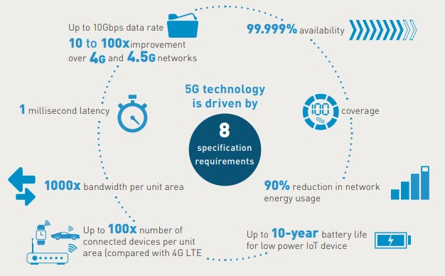
Specification
5G Technology is driven by 8 specification requirements:

Slide 10
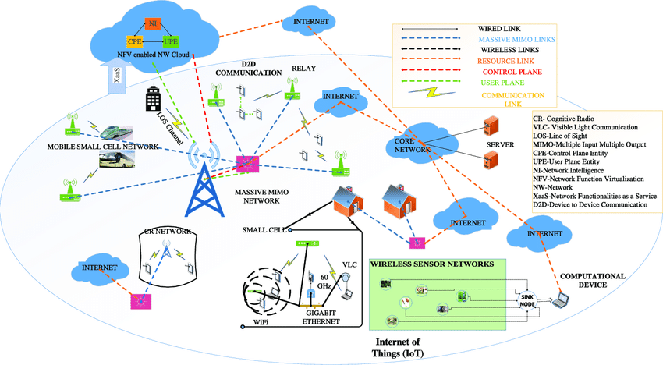
5G Network Architecture
A general 5G-cellular network architecture:

Slide 11
5G Use Cases
Each new generation wireless network came with all new set of new usages. The next coming 5G will make no exception and will be focused on IoT and critical communications applications.
We can mention following use cases over time:
Fixed wireless access (from 2018-2019 onwards)
Enhanced mobile broadband with 4G fall-back (from 2019-2020-2021)
Massive M2M / IoT (from 2021-2022)
Ultra low-latency IoT critical communications (from 2024-2025)
Some key applications like self-driving cars require very aggressive latency (fast response time) while they do not require fast data rates.
Conversely, enterprise cloud base services with massive data analysis will require speed improvements more than latency improvements.

Slide 12
5G Devices
Now a days many 5G enabled phones are available in market. e.g: Samsung Galaxy S20 series phones.
Qualcomm and quectel are also promises to deliver most secure 5G enabled IoT modules.

Slide 13
5G.!! When.? Where.?
The next generation mobile services on 5G technology is expected to become available in India for subscription in 2022, Swedish telecom gear maker Ericsson said in a report recently released. The company in an annual mobility report projected that 5G connections will account for 11 per cent of total subscription in India by 2025. Read more at: https://economictimes.indiatimes.com/industry/telecom/telecom-news/5g-subscription-in-india-to-become-available-in-2022-ericsson/articleshow/72228074.cms?utm_source=contentofinterest&utm_medium=text&utm_campaign=cppst

Slide 14
References
https://www.gemalto.com/mobile/inspired/5Gc :Gemalto website.
https://www.qualcomm.com/media/documents/files/qualcomm-5g-vision-presentation.pdf
https://www.qualcomm.com/invention/5g/ :Qualcomm website
https://www.researchgate.net/figure/5G-use-case-families-source-ITU-R-2015_fig1_327439779 : Researchgate (for figures)
https://www.researchgate.net/figure/A-general-5G-cellular-network-architecture_fig19_280873356 : Researchgate (for figures)
https://economictimes.indiatimes.com/industry/telecom/telecom-news/5g-subscription-in-india-to-become-available-in-2022-ericsson/articleshow/72228074.cms?from=mdr : IndiaTimes (for news)
https://www.youtube.com/watch?v=GEx_d0SjvS0 : 5G videos
https://spectrum.ieee.org/video/telecom/wireless

Slide 15
Thank You..!!

